Slide 1
Web Service Testing
Performance/Load/Stress Testing
Software Quality Assurance
Telerik Software Academy
http://academy.telerik.com

Slide 2

The Lecturer
Dimitar Topuzov
Principal QA Engineer @NativeScript Team
Email:
Dimitar.Topuzov@Telerik.com

Slide 3

Table of Contents
Best practices in Performance/Load/Stress Testing
Review of tools
SoapUI
JMeter
Others
Demos and practice with JMeter

Slide 4
Retrospective
Performance Testing
How fast is the system?
Load Testing
How much load can the system process?
Stress testing
Testing with conditions beyond the normally expected ones
Under what conditions the system will fail?

Slide 5
Metrics
Load testing metrics
Average Response Times
Peak Response Times
Error Rates
Throughput
Requests per Second
Concurrent Users
Resources
Load Testing metrics explained

Slide 6
Please have in Mind…
Monitoring Servers
CPU Usage
Memory Usage
Disk Usage
Network Usage
Errors

Slide 7
Monitoring Servers
Windows
Task Manager
Recourse Monitor (resmon)
Tutorial
Performance Monitor (perfmon)
Linux / OSX
“top” command
Tutorial 1
Tutorial 2

Slide 8
Please have in Mind…
Performance/Load/Stress testing require a lot more knowledge compared to functional testing
OS
Networking
Hardware

Slide 9
Please have in Mind…
Planning the Test is more important than actual implementation!
Planning the Test is more mathematics then testing
Planning involves a lot of calculations
Number of users under average load
Calculate pick loads
Calculate think times

Slide 10
Please have in Mind…
Use some kind of concurrency calculator
Sample Calculator
How to calculate VU (article)
How to calculate VU (another article)
How to calculate VU (one more article)
Use think times (with deviations)
It not only mimics real world usage better, but it allows for your agents I/O to not be as congested

Slide 11
Please have in Mind…
Start Perf/Load testing only if systems works correctly (functional tests passed)
Make sure you have stable Environment
Environment must have same resources during each test execution
No other random actions should be done during performance/load/stress tests
If possible use same hardware resources as Live System
If possible use separate environment (specially when perform stress tests)

Slide 12
Please have in Mind…
Base testing scenarios on real data (if possible)
In best case use data from some analytics/monitoring solution that give you meaningful data in easy way
If you have no analytics/monitoring solutions try to introduce such
If there is no chance for analytics/monitoring try to find some kind of logs of the SUT and try to analyze them
Guess only as a last resort

Slide 13
Please have in Mind…
(If Guess) Think about real scenarios
How many users will go through different workflows
Some operations/features might be used much more than other

Slide 14
Please have in Mind…
Test Data
Make sure you have enough random data for each virtual user
Make sure your test data is close to live data in terms of size and content
Specially in case test data is big (images, videos)

Slide 15
Please have in Mind…
(For Load Testing) Use ramp times to build up your users from a small number to larger numbers
In this way you will find the critical point at which system stops working as expected
Use more Agents if needed
The more agent machines you use, the more networking ports you can use at any one time, freeing up congestion on the agent side

Slide 16

Tooling
Notes:
Demos should be delivered in parallel with slides presentation.

Slide 17
Tools
SmartBear offering
SoapUI
Can be used only for simple scenarios
Does not support distributed load testing
LoadUI
Free edition with virtual user limit
PRO version for serious load testing
Support distributed load testing

Slide 18
Tools
JMeter
Free (open source)
Java Desktop Application (cross-platform)
Support a lot of protocols
HTTP, SMTP, POP3, LDAP, JDBC, FTP, JMS, SOAP, TCP
Support distributed load testing
There are services which can run your JMeter tests from the cloud

Slide 19
JMeter
Requirements
JDK 1.6 +
Hardware: Depends on what we want to simulate
Installation
Install JDK
Add JDK to Path (if not already added)
Verify installation by running “java -version” on command prompt
Install JMeter
Download
Extract
(Optional) Add to Path

Slide 20
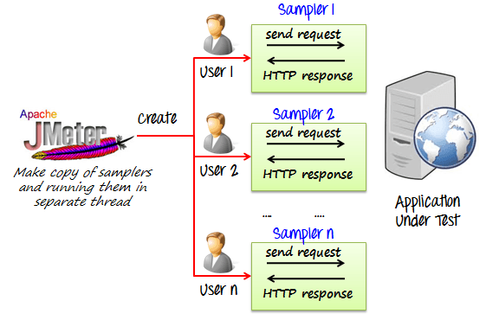
JMeter
How JMeter works

Slide 21
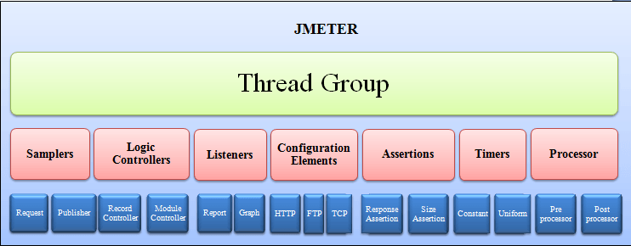
JMeter
JMeter elements schema

Slide 22
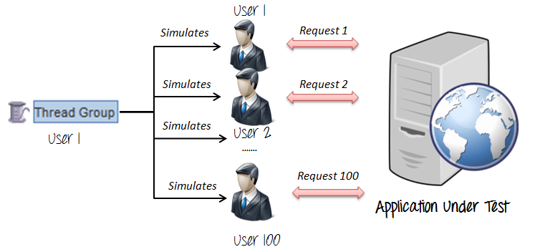
JMeter
Thread Group
Thread Groups is a collection of Threads
Each thread represents one user using the application under test

Slide 23
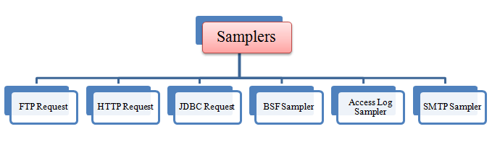
JMeter
Samplers
Sampler is type of Request (Protocol) we want to use in our tests
HTTP, FTP , JDBC, POP3 …

Slide 24
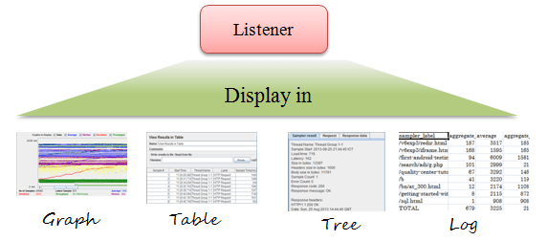
JMeter
Listeners
Shows the results of the test execution
They can show results in different format such as tree, table, graph or log file

Slide 25
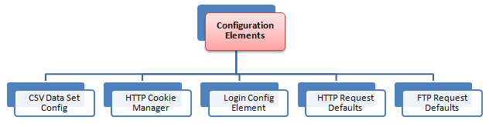
JMeter
Configuration Elements
Set up defaults and variables for later use by samplers

Slide 26
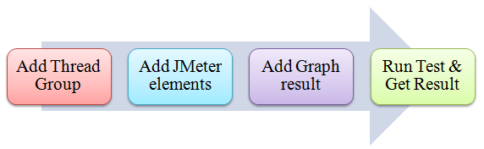
JMeter
JMeter project workflow

Slide 27
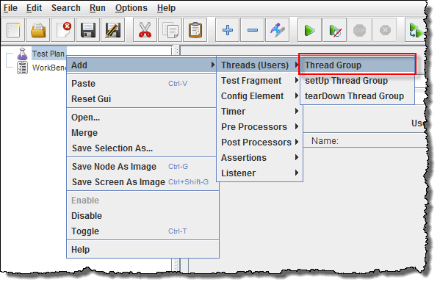
JMeter
Add Thread Group
Start JMeter
Select Test Plan on the tree
Right click on the Test Plan and add a new thread group: Add -> Threads (Users) -> Thread Group

Slide 28
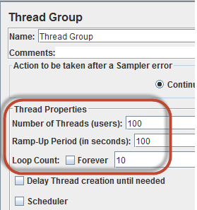
JMeter
Thread Group Properties
Number of Threads
Number of users connects to target website/service
Loop Count
Number of time to execute testing
Ramp-Up Period
Delay before starting next user

Slide 29
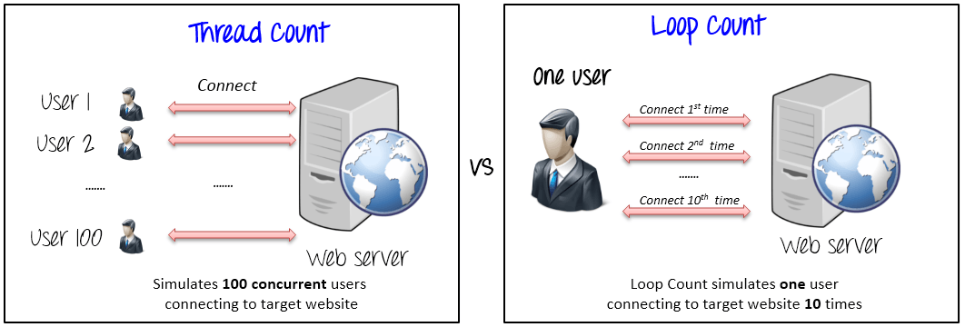
JMeter
The Thread Count and The Loop Counts are different

Slide 30
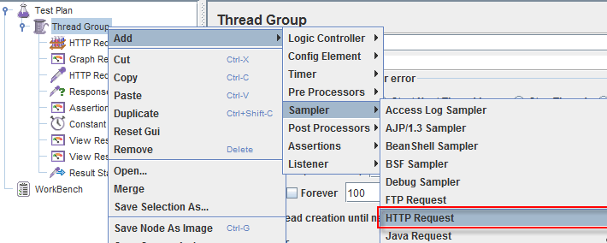
JMeter
Adding JMeter elements
Right-click on Thread Group and select: Add -> Sampler -> HTTP Request

Slide 31
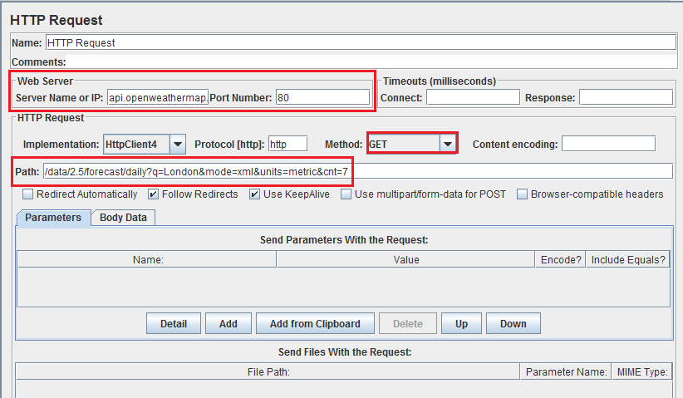
JMeter
HTTP Request

Slide 32
JMeter
How to use Timers in JMeter
Constant Timer
Thread Group -> Timer -> Constant Timer
Delays each user request for the same amount of time
Gaussian Random Timer
Gaussian random timer delays each user request for a random amount of time
Uniform Random Timer
Uniform random timer delays each user request for a random amount of time

Slide 33
JMeter
How to use Assertions in JMeter
Assertion help verify that your server under test returns the expected results
Be careful:
Sometimes asserts add additional resource usage to client machines
Sometimes asserts might add additional timing and change the results

Slide 34
JMeter
Commonly used Assertion in JMeter
Response Assertion
Thread Group -> Add -> Assertions -> Response Assertion
Assert Response contains Text
Assert Response Status Code is correct
Duration Assertion
Size Assertion
XML Assertion
HTML Assertion

Slide 35
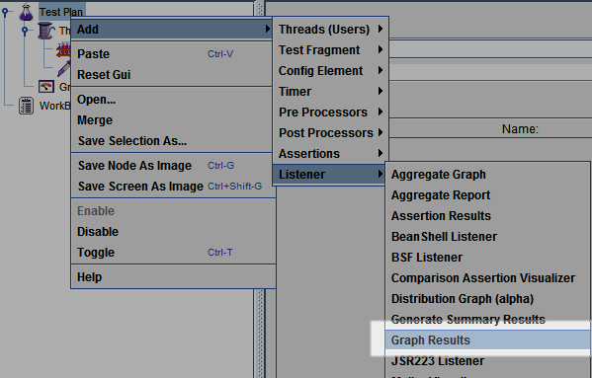
JMeter
Adding Graph Results
Right click Test Plan, Add -> Listener -> Graph Results

Slide 36
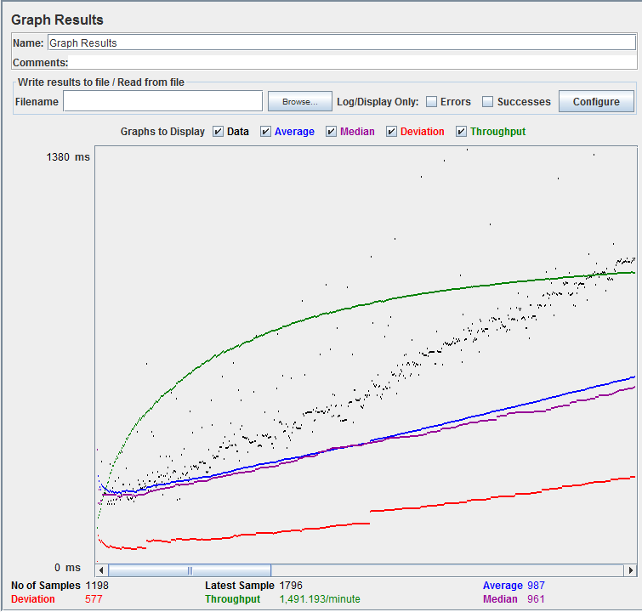
JMeter
Run Tests and get results
Press Run button (Ctrl + R) on Toolbar to start the testing process. You will see the test result display on Graph at the real time

Slide 37
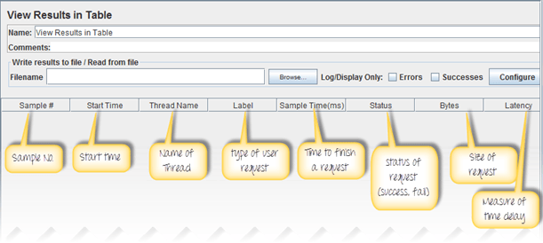
JMeter
View Results in Table
Right click Add -> Listener -> View Result in Table

Slide 38
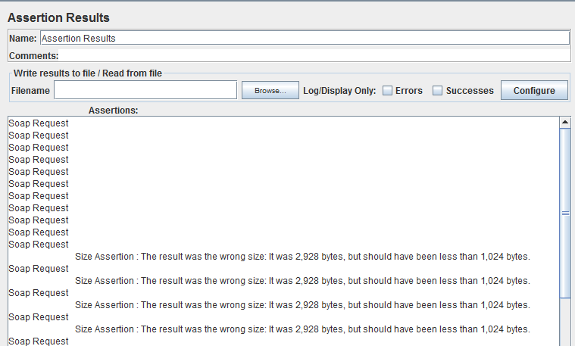
JMeter
View Assertion Results
Right click Thread Group, Add -> Listener -> Assertion Results

Slide 39
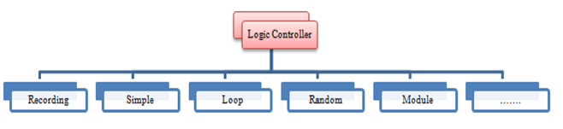
JMeter
Logic Controllers
Logic Controllers let you define the order of processing request in a Thread
Logic Controllers determine the order in which user request are executed

Slide 40
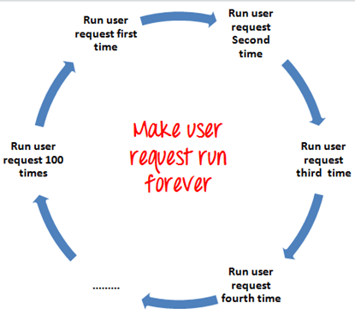
JMeter
Loop Controller
Loop Controller makes the user request run specified number of times or run forever as shown in figure

Slide 41
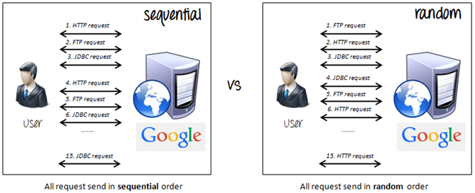
JMeter
Random Controller
Random Controller makes all the user requests run in random order in each loop period

Slide 42
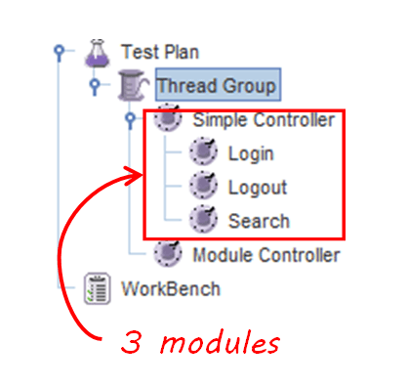
JMeter
Module Controller
The goal of Module Controller is to add modularity to JMeter

Slide 43
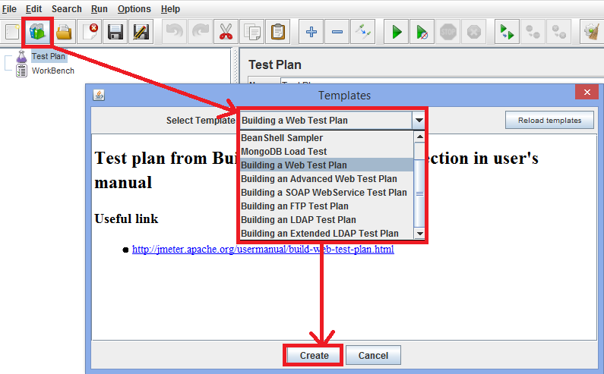
JMeter
Build-in Templates

Slide 44
JMeter
Plugins
JMeter Plugins
PerfMon Metrics Collector and Server Agent can be used for automated monitoring of servers during load/stress test

Slide 45
JMeter
Hints for Reducing Resource requirements
Use non-GUI mode: jmeter -n -t test.jmx -l test.jtl
Use as few Listeners as possible; if using the -l flag as above they can all be deleted or disabled
Use CSV output rather than XML
Only save the data that you need
Use as few Assertions as possible

Slide 46
JMeter
Additional Resources
Official Documentation
The Ultimate JMeter Tutorial
Tutorial for Distributed Load Testing

Slide 47
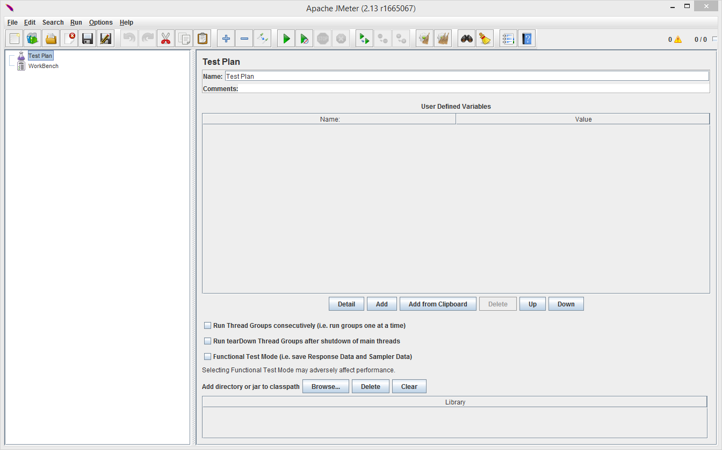
Demo
Notes:
Demos should be delivered in parallel with slides presentation.

Slide 48
Web Service Testing
?
?
?
?
?
Questions?
?
?
?
?
?
?

Slide 49




Free Trainings @ Telerik Academy
C# Programming @ Telerik Academy
csharpfundamentals.telerik.com
Telerik Software Academy
academy.telerik.com
Telerik Academy @ Facebook
facebook.com/TelerikAcademy
Telerik Software Academy Forums
forums.academy.telerik.com

